Slide 1

MVC and Android
Henry Tang
hktang@ualberta.ca
Department of Computing Science
University of Alberta
CMPUT 301 – Introduction to Software Engineering
Slides adapted from Dr. Hazel Campbell, Dr. Ken Wong, and Dr. Abram Hindle
Images reproduced in these slides have been included under section 29 of the Copyright Act, as fair dealing for research, private study, criticism, or review. Further distribution or uses may infringe copyright.

Slide 2
Model/View/Controller Roles
Model:
Entity layer
Complete, self-contained representation of the data managed by the application
Provides services to manipulate this data
“The back end”
Main responsibilities
Representation and computation issues
Sometimes persistence

Slide 3
MVC Roles
View:
Boundary layer
Set of user interface components determines what is needed for a particular perspective of the data
“The front end” or what the user sees
Main responsibility
Display the current data
Presentation issues

Slide 4
MVC Roles
Controller:
Control layer
Handles events and uses appropriate information from user interface components to modify the model
Main responsibility
Interaction issues

Slide 5
Views
Need to maintain consistency in the views
Want clear, separate responsibilities for presentation, interaction, computation, and representation
Data
Need to update multiple views of the common data model
Model

Slide 6
Views (i.e., observers, clients)
Modify
Data
Represented by entity objects
Modify
Model (i.e., subject, server)

Slide 7
Views (i.e., observers, clients)
Update
Update
Update
Modify Update
Data
Model (i.e., subject, server)

Slide 8
Views (i.e., observers, clients)
Request
Request Request
Modify
Update
Request
Data
Model (i.e., subject, server)

Slide 9


Can create new, specific types of views without changing the model
«Boundary»
View
«Control»
Controller
Update
«Entity»
Model
Modify
Notification
The model should not need to know the particulars of a specific view
The model should not need to know about any controllers
Notes:
The Controller does not own the data. It receives an action, like “jump button,” then asks the Model to change. The View does not own the data either. It displays whatever the Model currently says.
This separation lets us change the UI without rewriting the app’s core data logic.

Slide 10
MVC Sequence
User interacts with the View
Controller handles the interaction
Controller modifies the Model
Model changes state
View updates based on the Model

Slide 11
MVC Design Issues
Android UI-Dependent part:
Views contain Android UI components
XML layouts, Compose UI, Button, TextView, RecyclerView, etc.
Controllers handle Android UI events
Click listeners, text-change listeners, menu actions, navigation events
Android UI-Independent part:
Model should be as Android-free as possible
E.g., avoid using Android UI types in entity/data classes
Avoid TextView, Button, Context, Activity, Fragment, etc. in Model classes

Slide 12
“MV” Design
Generalization:
Use “model” superclass and “view” interface
All models keep track of their views
When changed, all models notify their views to update
All views update themselves when notified
Have application-specific model and view classes

Slide 13
Model-View Update Example
interface ViewObserver<M> {
fun update( model: M )
}
open class ObservableModel<M> {
private val observers = mutableListOf< ViewObserver<M> >()
// “all models keep track of their views”
fun addObserver( o: ViewObserver<M> ) { … }
fun removeObserver( o: ViewObserver <M> ) { … }
// “all models notify their views to update”
protected fun notifyObservers( model: M ) { … }
}

Slide 14
Java Observer – java.util.Observable superclass
public class Observable {
…
public Observable() { … }
// “all models keep track of their views”
public void addObserver( Observer o ) { … }
public void deleteObserver( Observer o ) { … }
// “all models notify their views to update”
public void notifyObservers() { … }
public void notifyObservers( Object arg ) { … }
// note whether the model has changed
public boolean hasChanged() { … }
protected void clearChanged() { … }
protected void setChanged() { … }
…
}

Slide 15
Java Observer – java.util.Observer interface
public class Observer {
public void update( Observable s, Object arg );
}

Slide 16
Model-View Update Example
// MyModel.kt
class MyModel : ObservableModel<MyModel>() {
var message: String = “”
private set
fun updateMessage( newMessage: String ) {
message = newMessage
notifyObservers(this) // notify views to update
}
}

Slide 17
Model-View Update Example
// MyView.kt
class MyView : ViewObserver<MyModel> {
override fun update( mode: MyModel ) {
println( model.message() )
}
}

Slide 18
Model-View Update Example
// MyApp.kt
fun main() {
val theModel = MyModel()
val aView = MyView()
val anotherView = MyView()
theModel.addObserver( aView )
theModel.addObserver( anotherView )
theModel.updateMessage( "hello" )
}

Slide 19
MVC Design
Approach:
Use a framework that supports MVC to help structure an interactive application
Framework is a set of cooperating classes, interfaces, and conventions that forms a reusable design in a particular domain
Reusable design and code

Slide 20
MVC Framework

Slide 21
Who is in Control?
Class library reuse
Application developers:
Write the main body of the application
Reuse library code by calling it
Framework reuse
Application developers:
Reuse the main body of the application
Write code that the framework calls
Reuse library code by calling it

Slide 22
Framework
Separation of concerns:
Framework
Skeletal application code
General superclasses and interfaces
Your “customizations”
Specific subclasses and implementations
Define app-specific models, views, and controllers

Slide 23
Exercise
Design an MVC framework for building interactive applications.

Slide 24
Generic MVC Structure
// MVC.kt
…
interface View< M > {
fun render( model: M )
}
interface Controller {
fun onUserAction() // Handles user actions
}

Slide 25
Generic Model
Generic Model Rules:
The Model stores application state
The Model contains application rules and calculations
The Model should avoid Android UI types
The Model may notify Views when its state changes

Slide 26
Generic Model
// ObservableModel.kt
…
open class ObservableModel<M> {
private val views = mutableListOf<View<M>>()
fun addView( view: View<M> ) {
if ( view !in views ) {
views.add( view )
}
}

Slide 27
Generic Model
fun removeView(view: View<M>) {
views.remove(view)
}
protected fun notifyViews( model: M ) {
views.forEach { view ->
view.render( model )
}
}

Slide 28
Generic Controller
// Controller.kt
…
class MyController(
private val model: MyModel
) {
fun onUserAction() {
// validate input
// modify the model
}
}

Slide 29
Generic View
// MyView.kt
…
class MyView : View<MyModel> {
override fun render( model : MyModel) {
// update the UI using model state
}
}

Slide 30
Connecting MVC
// MyApp.kt
…
val model = MyModel()
val view = MyView()
val controller = MyController(model)
model.addView(view)
// UI event delegates to the controller
// e.g., when a button is clicked, call
controller.onUserAction()
}

Slide 31
Multiple Views
// MyApp.kt
…
val model = MyModel()
model.addView( summaryView )
model.addView( detailView )
model.addView( chartView )
// One Model can update multiple Views
}

Slide 32
Generic MVC Flow
User action:
User interacts with View
View delegates interaction to Controller
Controller response:
Controller validates and handles the interaction
Controller invokes changes on the Model
Model update:
Model changes state
Model notifies registered Views
View refresh:
Views update based on the Model

Slide 33
“Code Reuse”
http://www.dilbert.com
/strips/comic/1996-01-31/

Slide 34
Example Template
class SomeModel : ObservableModel<SomeModel>() {
fun changeState() {
// update state
notifyViews(this)
}
}
class SomeView : View<SomeModel> {
override fun render( model: SomeModel ) {
// display model state
}
}
class SomeController(
private val model: SomeModel
) {
fun onUserAction() {
model.changeState()
}
}

Slide 35
MVC Responsibility Checklist Example
Question | Belongs in
What data does the application store? | Model
What rules protect or change the data? | Model
What methods change application state? | Model
How is the current state displayed? | View
Which UI components are shown? | View
What happens when the user clicks or types? | Controller
Which Model method should be called for this action? | Controller
Who notifies registered Views after state changes? | Model
Who updates the screen after notification? | View
Who delegates the user interaction to the Controller? | View

Slide 36
Implementing MVC
Framework:
Implement using generic base classes and interfaces for Model and View

Slide 37
TView
// TView.kt
interface TView<M> {
fun update( model: M )
}

Slide 38
TModel
// TModel.kt
abstract class TModel<M, V: TView<M> > {
private val views = mutableListOf<V>()
fun addView( view: V ) {
if ( view !in views ) {
views.add( view )
}
}

Slide 39
fun deleteView( view: V ) {
views.remove( view )
}
protected fun notifyViews(model: M) {
views.forEach { view ->
view.update( … )
}
}
…
}

Slide 40
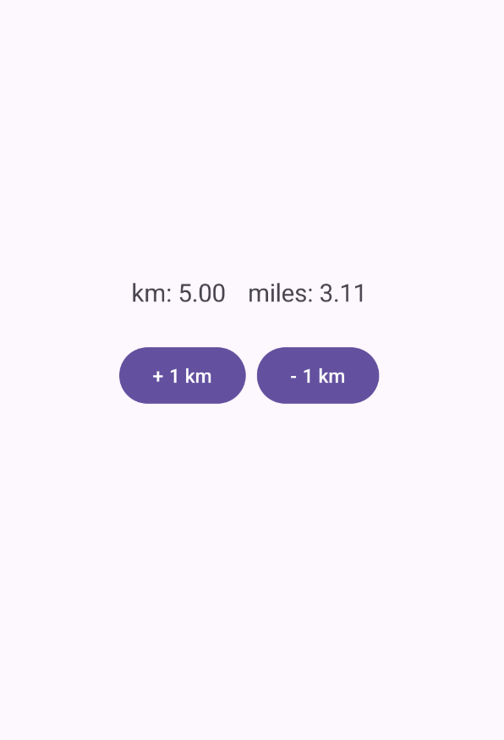
Example Custom Application

Slide 41
Custom View
// MyLabelView.kt
…
class MyLabelView(
labelText: String,
private val multiplier: Double
) : TView<MyModel> {
companion object {
private val twoPlaces = DecimalFormat( “0.00” )
}
private val panel = JPanel()
private val labelView = JLabel( labelText )
private val valueView = JLabel( “ ” )
Notes:
Swing style slides in Kotlin

Slide 42
Custom View
init{
panel.add( labelView )
panel.add( valueView )
}
val component: JComponent
get() = panel
override fun update( model: MyModel ) {
val value = model.value * multiplier
valueView.text = twoPlaces.format( value )
}
}

Slide 43
Custom Model
// MyModel.kt
class MyModel: TModel< MyModel, TView<MyModel> >() {
var value: Int = 0
private set
fun setValue ( newValue: Int ) {
value = maxOf( 0, newValue )
notifyViews()
}
}

Slide 44
Custom Application
// MyApp.kt
…
class MyApp(
title: String,
model: MyModel
) : TApp<MyModel>(title, model) {
init {
// create the UI
val myMainView = MyMainView(this, model)
// register the main view with the model
model.addView(myMainView)
}
}

Slide 45
Custom Application
fun main() {
val model = MyModel()
val app = MyApp(“MyApp”, model)
model.setValue(0)
app.content.preferredSize =
Dimension(400, 200)
app.show()
}

Slide 46
Custom User Interface
// MyMainView.kt
…
class MyMainView(
private val app: MyApp,
private val model: MyModel
) : TView<MyModel> {
private val kmView: MyLabelView
private val milesView: MyLabelView
private val incrCommand: TCommand
private val decrCommand: TCommand
private val incrButton: JButton
private val decrButton: JButton

Slide 47
Custom User Interface
init{
// create views
kmView = MyLabelView(“km: ”, 1.0)
milesView = MyLabelView(
“miles: ”,
0.621371192
)
// register views with model
model.addView(kmView)
model.addView(milesView)

Slide 48
Custom User Interface
// create commands that modify the model
incrCommand = TCommand {
model.setValue(model.value + 1)
}
decrCommand = TCommand {
model.setValue(model.value - 1)
}

Slide 49
Custom User Interface
// views
app.addToContent( kmView.component )
app.addToContent( milesView.component)
// controls
incrButton = JButton( "+ 1 km" )
app.addToContent( incrButton )
decrButton = JButton( "­- 1 km" )
app.addToContent( decrButton )
// connect buttons to commands
TButtonController( incrButton, incrCommand )
TButtonController( decrButton, decrCommand )
}

Slide 50
Custom User Interface
override fun update( model: MyModel ) {
// nothing to do
}
}

Slide 51
UML Sequence Diagram
Object
New
Roles
:MyView
New
Activation box
:JButton
New
listener:MyListener
Time
addActionListener( listener )
Constructor
call
Synchronous method call
actionPerformed( … )
Lifeline

Slide 52
Exercise
Draw a UML sequence diagram for the behavior when a button is clicked in the example application.

Slide 53
Swing

Slide 54
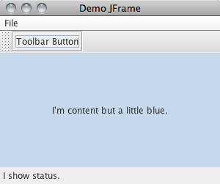
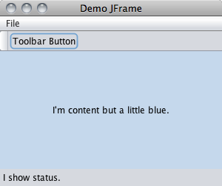
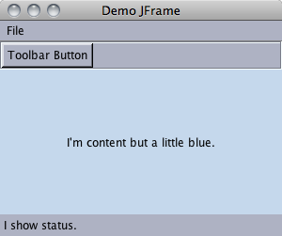
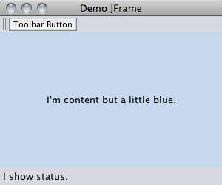
Metal
Nimbus
Motif
Mac OS X

Slide 55
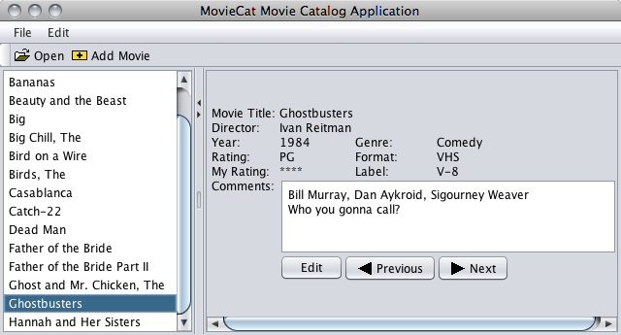
-Dswing.defaultlaf=com.sun.java.swing.plaf.nimbus.NimbusLookAndFeel

Slide 56
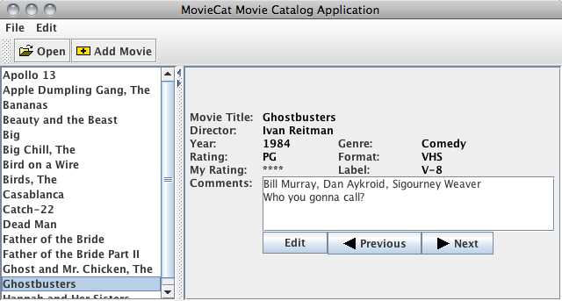
-Dswing.defaultlaf=javax.swing.plaf.metal.MetalLookAndFeel

Slide 57
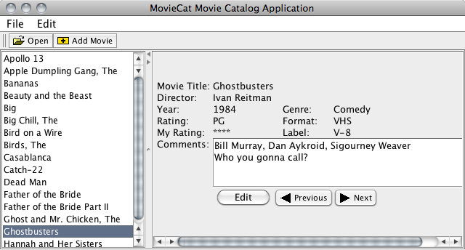
JFrame, JPanel
JMenuBar, JMenu, JMenuItem
JToolBar, JButton
JPanel, JList
JPanel
JSplitPane, JScrollPane

Slide 58
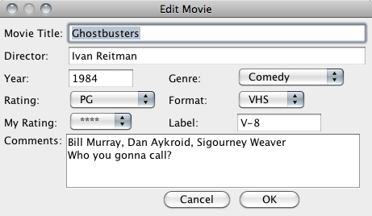
JDialog, JPanel
JLabel
JTextField
JComboBox
JScrollPane, JTextArea
JButton

Slide 59
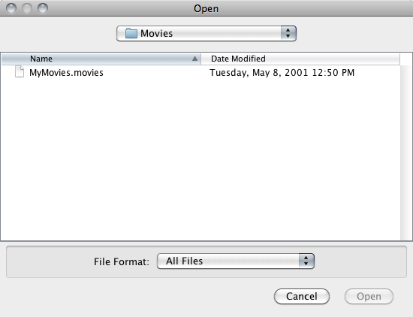
JFileChooser

Slide 60
Main Window
Typical containment setup steps:
Create a JFrame
Create and define a JMenuBar (optional)
Add this JMenuBar to the JFrame (optional)
Create a JPanel
Add components to this JPanel
Set JFrame content pane to this JPanel
Pack and show the JFrame

Slide 61


JFrame
+JFrame( title: String )
+setJMenuBar( menuBar: JMenuBar ): void
+setContentPane( contentPane: Container ): void
+pack(): void
+setVisible( visibility: boolean ): void
…
1
JMenuBar
+JMenuBar() +add( menu: JMenu ): JMenu
1
JPanel
+JPanel() +add( component: Component ): Component

Slide 62

Swing Main Window
// MyApp.kt
import javax.swing.JButton
import javax.swing.JFrame
import javax.swing.JMenuBar
import javax.swing.JPanel
fun main() {
val frame = JFrame( “Title” )
val menuBar = JMenuBar()
// code to define menu items, etc.
frame.jMenuBar = menuBar

Slide 63
val panel = JPanel()
// code to define components in the panel, layout
// manager, etc.
val button = JButton( “Hello” )
panel.add(button)
frame.contentPane = panel
frame.pack()
frame.isVisible = true
}

Slide 64

Swing Menu Items
// code to define menu items, etc.
val fileMenu = JMenu( “File” )
val newMenuItem = JMenuItem( “New” )
val openMenuItem = JMenuItem( “Open” )
fileMenu.add( newMenuItem )
fileMenu.add( openMenuItem )
menuBar.add( fileMenu )
val editMenu = JMenu( “Edit” )
…
menuBar.add( editMenu )

Slide 65
Events
Interactive applications are event driven:
Receive an event (e.g., initiated from user)
Check event and system state
Respond by changing state and display
Return and wait for another event
Event handling is done via:
Explicit event loop, event queue, and dispatcher
Registered callback through listeners

Slide 66
Event Handling
// MyListener.kt
class MyListener : ActionListener {
override fun actionPerformed(e: ActionEvent) {
// react to event
}
}

Slide 67
Implementing a Listener
// MyView.kt
class MyListener : ActionListener {
override fun actionPerformed( e: ActionEvent ) {
// react to event
}
}
class MyView {
init {
button.addActionListener( MyListener() )
}
}

Slide 68
Implementing a Listener
// without adapter class
class MyWindowHandler : WindowListener {
override fun windowClosing(e: WindowEvent) {
// respond to closing window
}
override fun windowOpened(e: WindowEvent) {}
override fun windowClosed(e: WindowEvent) {}
override fun windowIconified(e: WindowEvent) {}
override fun windowDeiconified(e: WindowEvent) {}
override fun windowActivated(e: WindowEvent) {}
override fun windowDeactivated(e: WindowEvent) {}
}
frame.addWindowListener(MyWindowHandler())

Slide 69
More Information
Books:
The Essence of Object-Oriented Programming with Java and UML
B. Wampler
Addison-Wesley, 2002
Java in a Nutshell
D. Flanagan
O’Reilly, 2005
Core Java 2: Fundamentals
C. Horstmann
Prentice-Hall, 2004

Slide 70
More Information
Books:
Learning Java
P. Niemeyer and J. Knudsen
O’Reilly, 2005
UML Distilled
M. Fowler
Addison-Wesley, 2003
The Elements of UML 2.0 Style
S. W. Ambler
Cambridge, 2005

Slide 71
More Information
Links:
The Swing Tutorial
https://docs.oracle.com/javase/tutorial/uiswing/
Java Standard Edition 6 API Specification
https://docs.oracle.com/javase/6/docs/api/
Java SE Application Design with MVC
https://www.oracle.com/technical-resources/articles/javase/application-design-with-mvc.html

